Slide 1
UNIT-II
1. Cataloging and indexing
2. Objectives
3. Indexing process
4. Information Extraction
T. Gnana Prakash
Asst. Prof , VNRVJIET

Slide 2
Indexing : the transformation from received item to searchable data structure is called indexing.
Process can be manual or automatic.
Creating a direct search in document data base or indirect search through index files.
Concept based representation: instead of transforming the input into a searchable format some systems transform the input into different representation that is concept based ..
Search ? Search and return item as per the incoming items.

Slide 3
History of indexing: shows the dependency of information processing capabilities on manual and then automatic processing systems .
Indexing originally called cataloging : oldest technique to identity the contents of items to assist in retrieval.

Slide 4
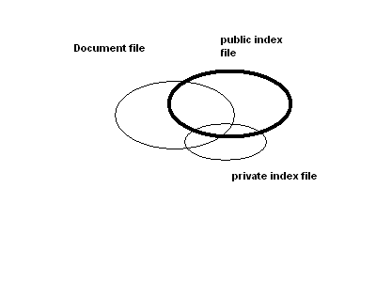
Objectives : the public file indexer needs to consider the information needs of all users of library system.
Items overlap between full item indexing , public and private indexing of files

Slide 5
Users may use public index files as part of search criteria to increase recall.
They can constrain there search by private index files
The primary objective of representing the concepts within an item to facilitate users finding relevant information .

Slide 6
Indexing process:
Decide the scope of indexing and the level of detail to be provided. Based on usage scenario of users .
Second decision is to link index terms together in a single index for a particular concept.

Slide 7
Scope of indexing:
When perform the indexing manually, problems arise from two sources the author and the indexer the author and the indexer .
Vocabulary domain may be different the author and the indexer.
This results in different quality levels of indexing.
The indexer must determine when to stop the indexing process.
Two factors to decide on level to index the concept in a item.
The exhaustively and how specific indexing is desired.
Exhaustively of index is the extent to which the different concepts in the item are indexed.
For example, if two sentences of a 10-page item on microprocessors discusses on-board caches, should this concept be indexed?

Slide 8
Specific relates to preciseness of index terms used in indexing.
For example, whether the term “processor” or the term “microcomputer” or the term “Pentium” should be used in the index of an item is based upon the specificity decision.
Indexing an item only on the most important concept in it and using general index terms yields low exhaustively and specificity.
Another decision on indexing is what portion of an item to be indexed Simplest case is to limit the indexing to title and abstract(conceptual ) zone .
General indexing leads to loss of precision and recall.

Slide 9
Preordination and linkages
Another decision on linkages process whether linkages are available between index terms for an item .
Used to correlate attributes associated with concepts discussed in an item .’this process is called preordination .
When index terms are not coordinated at index time the coordination occurs at search time. This is called post coordination , implementing by “AND” ing index terms .
Factors that must be determined in linkage process are the number of terms that can be related.
Ex., an item discusses ‘the drilling of oil wells in Mexico by CITGO and the introduction of oil refineries in Peru by the U.S.’

Slide 10
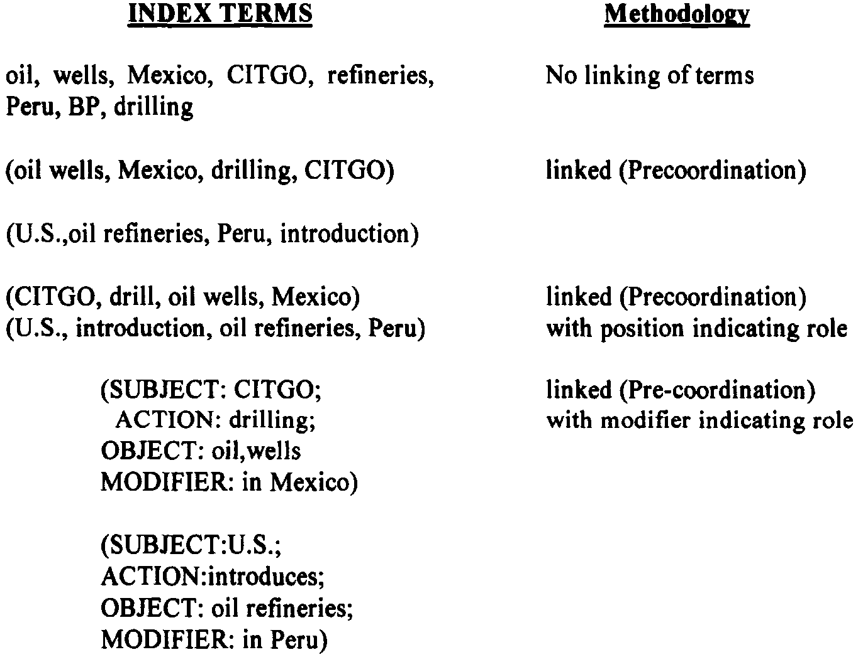

Slide 11
Automatic indexing :
Case: Total document indexing .
Automatic indexing requires few seconds based on the processor and complexity of algorithms to generate indexes.’
Adv. is consistency in index term selection process.
Index resulting form automated indexing fall into two classes , weighted and un weighted .
Un weighted indexing system : the existence of an index term in a document and some times its word location are kept as part of searchable data structure .
Weighted indexing system: a attempt is made to place a value on the index term associated with concept in the document . Based on the frequency of occurrence of the term in the item .

Slide 12
Values are normalized between 0 and 1.
The results are presented to the user in order of rank value from highest number to lowest number .
Indexing By term
Terms (vocabulary) of the original item are used as basis of index process .
There are two major techniques for creation of index statistical and natural language .
Statistical can be based upon vector models and probabilistic models with a special case being Bayesian model(accounting for uncertainty inherent in the model selection process) .
Called statistical because their calculation of weights use information such as frequency of occurrence of words .

Slide 13
Natural language also use some statistical information , but perform more complex parsing to define the final set of index concept .
Other weighted systems discussed as vectorized information system .
The system emphasizes weights as a foundation for information detection and stores these weights in a vector form.
Each vector represents a document . And each position in a vector represent a unique word (processing token ) in a data base..
The value assigned to each position is the weight of that term in the document.
0 indicates that the word was not in the document .
Search is accomplished by calculating the distance between the query vector and document vector .

Slide 14
Bayesian approach : based on evidence reasoning( drawing conclusion from evidence )
Could be applied as part of index term weighing . But usually applied as part of retrieval process by calculating the relation ship between an item and specific query.
Graphic representation each node represents a random variable arch between the nodes represent a probabilistic dependencies between the node and its parents .
c1
Two level Bayesian network
“ c”“ represents concept in a query
“f”representing concepts in an item
f11
f12
f1j

Slide 15
Goal is calculate c1 given f1j.
Need two sets of probability .
P(c1) item is relevant to “c”.
Conditional probability P(fij/c1) that the features f1j where j= 1,..m are present in an item that contains in topic c1
Automatic indexing task is to calculate posterior probability .
Bayes inference formula that is used
P(ci/fi1……fim) = P(ci)P(fi1…….fim/ci)]\P(fi1..fim)
If it provide ranking as the result then can be simplified,Linear rule.
g(ci/fi1….fim) = ∑kI(fik)w(fik,ci)
I (fik)= 1 only if fik is present its an indicator variable.
“w” is a coefficient corresponding to specific feature / concept pair . Produces a ranking in decreasing order .

Slide 16
Another approach is natural language processing.
DR-LINK( document retrieval through linguistics knowledge )
Indexing by concept
Concept indexing determines a canonical set of concept based upon a test set of terms and uses them as base for indexing all items. Called latent semantics indexing .
Ex: matchplus system developed by HNC inc
Uses neural NW strength of the system word relationship (synonyms) and uses the information in generating context vectors.
Two neural networks are used one to generated stem context vectors and another one to perform query.

Slide 17
Interpretation is same as the weights.
Multimedia indexing:
Indexing video or images can be accomplished at raw data level.
Positional and temporal (time) search can be done.

Slide 18
Information extraction
There are two processes associated with information extraction:
  determination of facts to go into structured fields in a database and
  extraction of text that can be used to summarize an item.
The process of extracting facts to go into indexes is called Automatic File Build.
In establishing metrics to compare information extraction, precision and recall are applied with slight modifications.
Recall refers to how much information was extracted from an item versus how much should have been extracted from the item.

Slide 19
It shows the amount of correct and relevant data extracted versus the correct and relevant data in the item.
Precision refers to how much information was extracted accurately versus the total information extracted.
Additional metrics used are overgeneration and fallout.
Overgeneration measures the amount of irrelevant information that is extracted.
This could be caused by templates filled on topics that are not intended to be extracted or slots that get filled with non-relevant data.
Fallout measures how much a system assigns incorrect slot fillers as the number of potential incorrect slot fillers increases.

Slide 20
These measures are applicable to both human and automated extraction processes.
Another related information technology is document summarization.
Rather than trying to determine specific facts, the goal of document summarization is to extract a summary of an item maintaining the most important ideas while significantly reducing the size.
Examples of summaries that are often part of any item are titles, table of contents, and abstracts with the abstract being the closest.
The abstract can be used to represent the item for search purposes or as a way for a user to determine the utility of an item without having to read the complete item.

